Slide 1
Logic Design 1st Term Project
-Double digit BCD calculator-
TA: 최승훈 E-mail: csh30096@korea.ac.kr
SoC & Microprocessor Research Laboratory

Slide 2
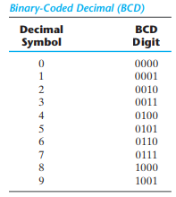
Double digit BCD calculator
BCD(Binary Coded Decimal)
Decimal 36 is represented in BCD with 8 bits as 0011 0110, with each group of 4 bits representing one decimal digit.
Notes:
비헤이비어럴(Behavioral) 레벨 모델링
Initial 구문
- 시간은 0에서 시작
- 시뮬레이션에서 한번만 수행
- initial 블록이 여러 개일 경우 동시에 수행
- initial 블록 안에 여러 문장이 있는 경우 begin end로 묶어 줌

Slide 3
Double digit BCD calculator
Scenario
Input
Input1: 1bit (SW[16], operator)
Available Operation: + (0), - (1)
Input2: 4bit (SW[15:12], data_in1)
Input3: 4bit (SW[11:8], data_in2)
Input4: 4bit (SW[7:4], data_in3)
Input5: 4bit (SW[3:0], data_in4)
Output
Output1: 7bit (HEX7[0:6], data_out1)
Output2: 7bit (HEX6[0:6], data_out2)
Output3: 7bit (HEX5[0:6], data_out3)
Output4: 7bit (HEX4[0:6], data_out4)
Output5: 7bit (HEX1[0:6], result_out1)
Output6: 7bit (HEX0[0:6], result_out2)
Output7: 1bit (LEDG8, overflow_underflow)

Slide 4
Double digit BCD calculator
Input2_Input3 (operate(Input1)) Input4_Input5 = Output5_Output6
Ex 1) 74 + 13 = 87
Input2(SW[15:12]) = 7(0111), Input3(SW[11:8]) = 4(0100)
Input4(SW[7:4]) = 1(0001), Input5(SW[3:0]) = 3(0011)
Input1(SW[16]) = 0 (+)
Output1(HEX7) = 7 (7’b000_1111)
Output2(HEX6) = 4 (7’b100_1100)
Output3(HEX5) = 1 (7’b100_1111)
Output4(HEX4) = 3 (7’b000_0110)
Output5(HEX1) = 8 (7’b000_0000)
Output6(HEX0) = 7 (7’b000_1111)
Output7(LEDG8) = 0 (Overflow, Underflow X)

Slide 5
Double digit BCD calculator
Input2_Input3 (operate(Input1)) Input4_Input5 = Output5_Output6
Ex 1) 13 – 74 = underflow
Input2(SW[15:12]) = 1(0001), Input3(SW[11:8]) = 3(0011)
Input4(SW[7:4]) =7(0111), Input5(SW[3:0]) = 4(0100)
Input1(SW[16]) = 1 (-)
Output1(HEX7) = 1 (7’b100_1111)
Output2(HEX6) = 3 (7’b000_0110)
Output3(HEX5) = 7 (7’b000_1111)
Output4(HEX4) = 4 (7’b100_1100)
Output5(HEX1) = X (7’b111_1111)
Output6(HEX0) = X (7’b111_1111)
Output7(LEDG8) = 1 (Underflow)

Slide 6
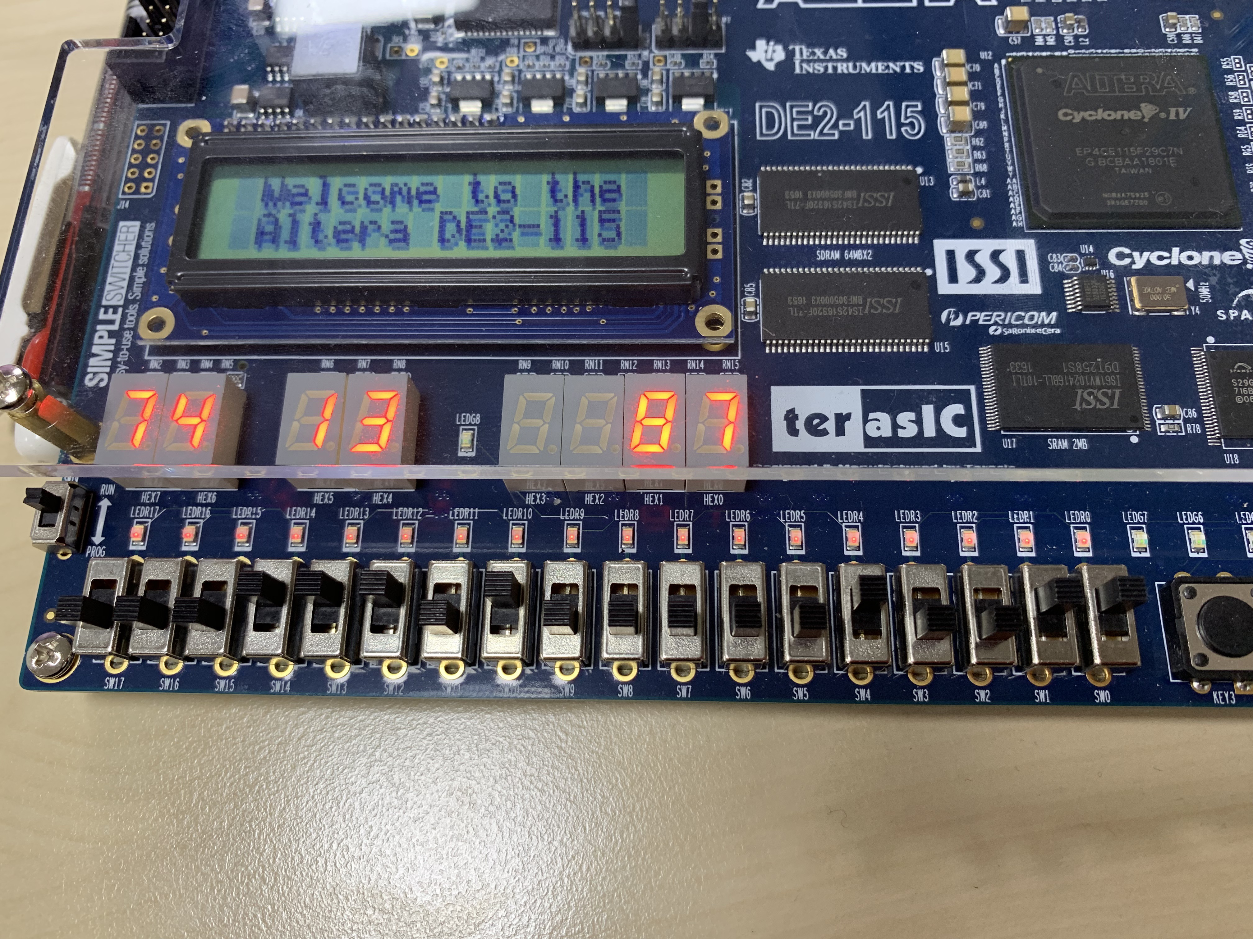
Double digit BCD calculator
Result Example
74+13=87
74+13 = 87
Input1
0 (+)
Input2
0111
Input3
0100
Input4
0001
Input5
0011

Slide 7
Double digit BCD calculator
Due Date: ~2019. 04. 12 15:29:59
Check Time: 2019.04.12 15:30 (room 202).
If you submit after the deadline, you will get zero point. (no point)
IF YOU TRY TO COPY&PASTE, YOU and YOUR FRIEND WILL GET “F”
Project (10 points)
Report (2 points)
Project Summary (0.5 points)
Simulation Screenshot (0.5 points)
HDL code (annotation should be included) (0.5 points)
Troubleshooting process (0.5 points)
Result (8 points)
Add (2 points)
Subtract (2 points)
Overflow (2 points)
Underflow (2 points)
Compress your Quartus VerilogHDL file(.v) and report to StudentID_Name(eng).zip, and send an e-mail to TA(csh30096@korea.ac.kr).
Notes:
비헤이비어럴(Behavioral) 레벨 모델링
Initial 구문
- 시간은 0에서 시작
- 시뮬레이션에서 한번만 수행
- initial 블록이 여러 개일 경우 동시에 수행
- initial 블록 안에 여러 문장이 있는 경우 begin end로 묶어 줌

Slide 8
4bit Full Adder Example Code
module midterm( input [7:0] SW, output reg [0:6] HEX0,HEX6,HEX4 );
reg [3:0] bit2, bit3;
wire [3:0] bit1;
wire car_1;
reg car_0;
parameter Seg9 = 7'b000_1100; parameter Seg8 = 7'b000_0000; parameter Seg7 = 7'b000_1111; parameter Seg6 = 7'b010_0000; parameter Seg5 = 7'b010_0100;
parameter Seg4 = 7'b100_1100; parameter Seg3 = 7'b000_0110; parameter Seg2 = 7'b001_0010; parameter Seg1 = 7'b100_1111; parameter Seg0 = 7'b000_0001;
full_adder fulladd (bit1, car_1, bit2, bit3, car_0); // Create Module fulladd
always @(*)
begin
bit2 = SW[7:4];
bit3 = SW[3:0];
car_0 = 1'b0;
end
always @(*)
begin
case(SW[7:4])
9:HEX6=Seg9; 8:HEX6=Seg8; 7:HEX6=Seg7; 6:HEX6=Seg6;
5:HEX6=Seg5; 4:HEX6=Seg4; 3:HEX6=Seg3; 2:HEX6=Seg2;
1:HEX6=Seg1; 0:HEX6=Seg0; default: HEX6 = 7'b1111111;
endcase
case(SW[3:0])
9:HEX4=Seg9; 8:HEX4=Seg8; 7:HEX4=Seg7; 6:HEX4=Seg6;
5:HEX4=Seg5; 4:HEX4=Seg4; 3:HEX4=Seg3; 2:HEX4=Seg2;
1:HEX4=Seg1; 0:HEX4=Seg0; default: HEX4 = 7'b1111111;
endcase
case(bit1)
9:HEX0=Seg9; 8:HEX0=Seg8; 7:HEX0=Seg7; 6:HEX0=Seg6;
5:HEX0=Seg5; 4:HEX0=Seg4; 3:HEX0=Seg3; 2:HEX0=Seg2; 1:HEX0=Seg1; 0:HEX0=Seg0; default: HEX0 = 7'b1111111;
endcase
end
endmodule
module full_adder(sum, car, a, b, cin);
output [3:0] sum;
output car;
input [3:0] a, b;
input cin;
wire [2:0] c;
assign sum[0]=a[0] ^ b[0] ^ cin;
assign c[0]=((a[0] ^ b[0]) & cin) | (a[0] & b[0]);
assign sum[1]=a[1] ^ b[1] ^ c[0];
assign c[1]=((a[1] ^ b[1]) & c[0]) | (a[1] & b[1]);
assign sum[2]=a[2] ^ b[2] ^ c[1];
assign c[2]=((a[2] ^ b[2]) & c[1]) | (a[2] & b[2]);
assign sum[3]=a[3] ^ b[3] ^ c[2];
assign car=((a[3] ^ b[3]) & c[2]) | (a[3] & b[3]);
endmodule

Slide 9
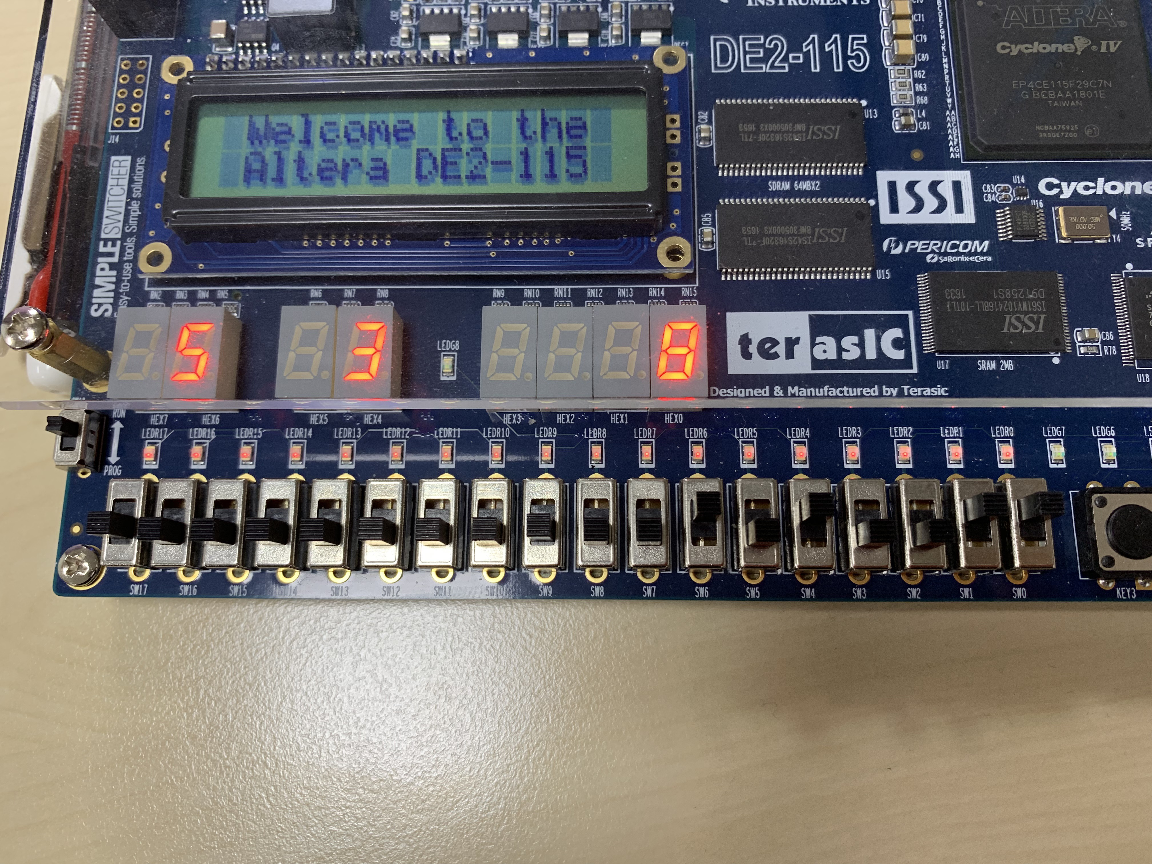
4bit Full Adder Example Code
Result Example
5+3=8
5+3=8
SW[7:4]
0101
SW[3:0]
0011

Slide 10
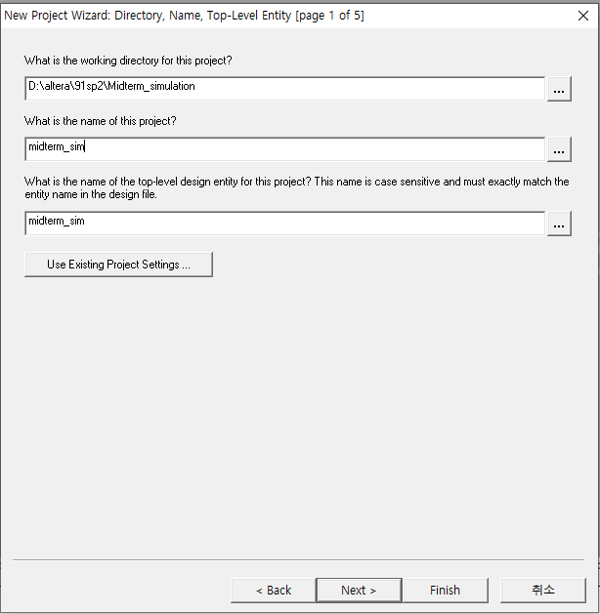
Simulation
Open a new project

Slide 11
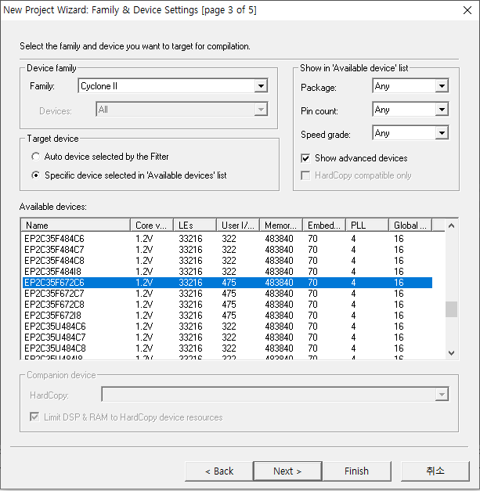
Simulation
Device – Cyclone II EP2C35F672C6

Slide 12
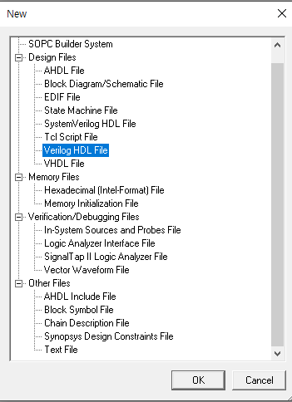
Simulation
File -> new -> Verilog HDL File

Slide 13
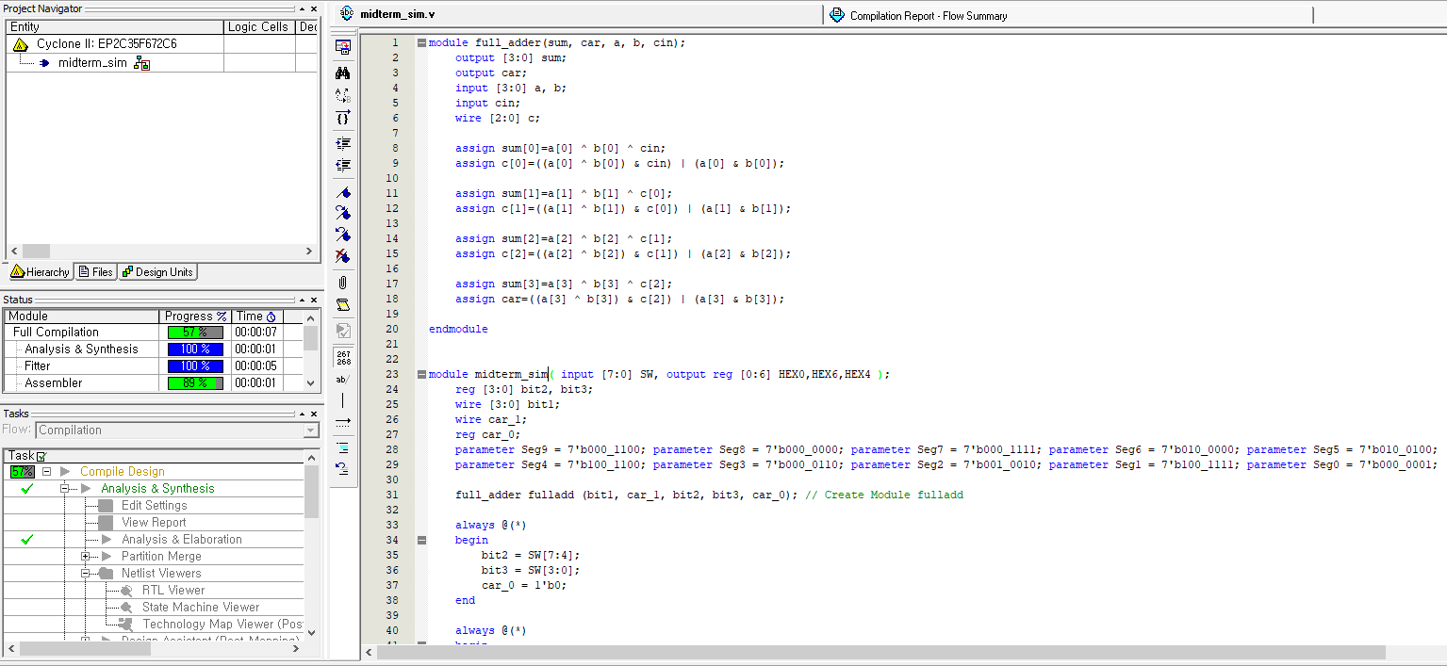
Simulation
Code Copy & Paste -> Save the VerilogHDL File -> Start Compile
Note the module name

Slide 14
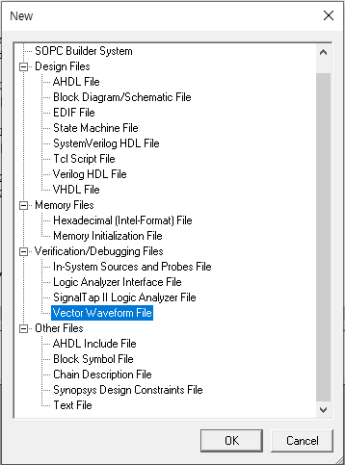
Simulation
File -> new -> Vector Waveform File

Slide 15
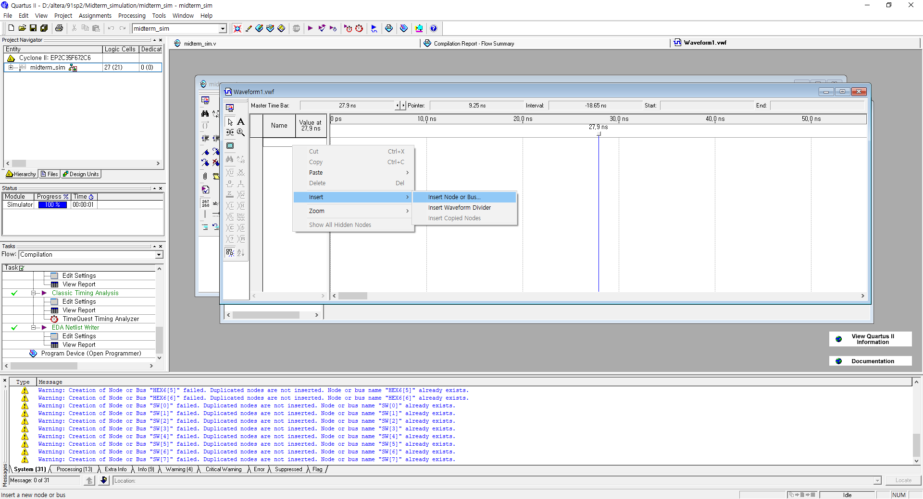
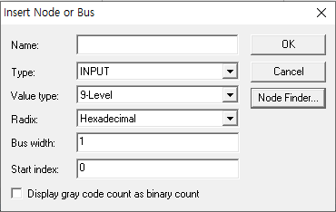
Simulation
Right Mouse Click -> Insert -> Insert Node or Bus.. -> Node Finder

Slide 16
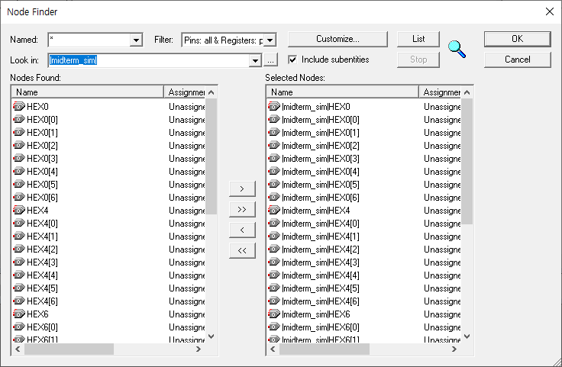
Simulation
List -> Select Nodes -> OK -> OK
1
4
2
Select !
3

Slide 17
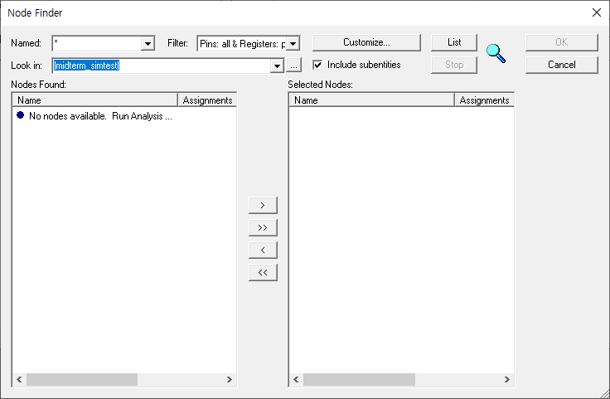
Simulation
If not synthesized, the following screen will be displayed.

Slide 18
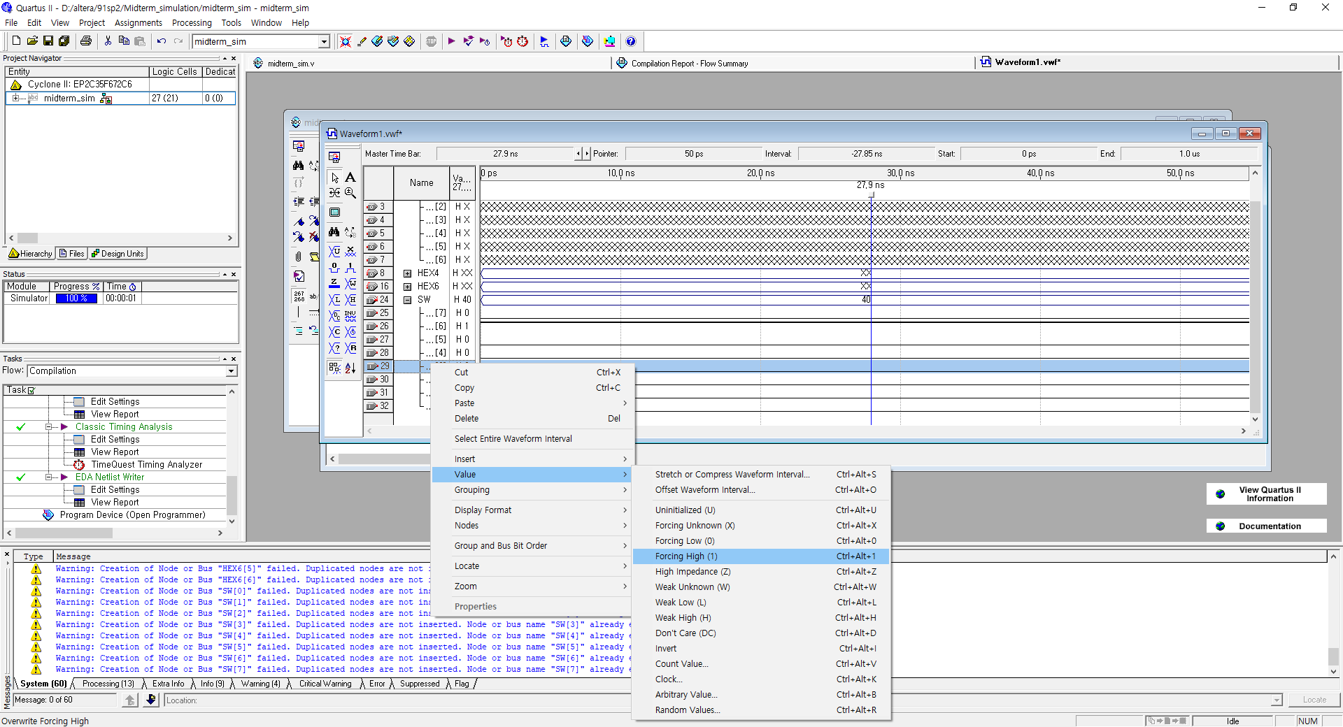
Simulation
Select SW -> Right Mouse Click -> Value -> Forcing High(1) or Low (0) -> Save the Waveform file in your simulation project folder

Slide 19
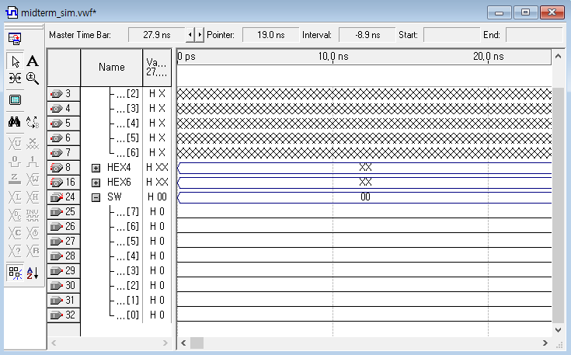
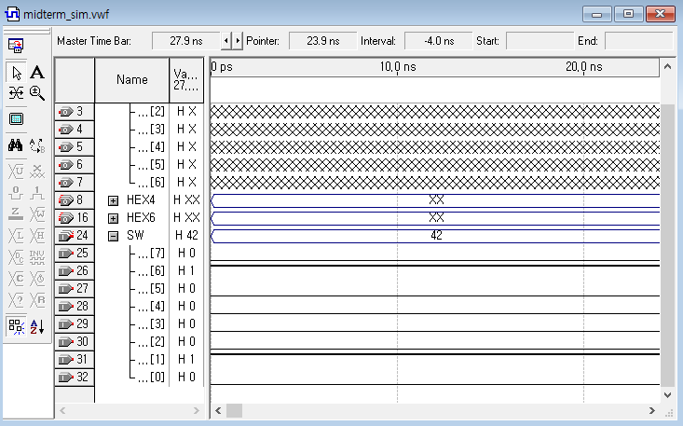
Simulation
After change the value of SW[6], SW[1]

Slide 20
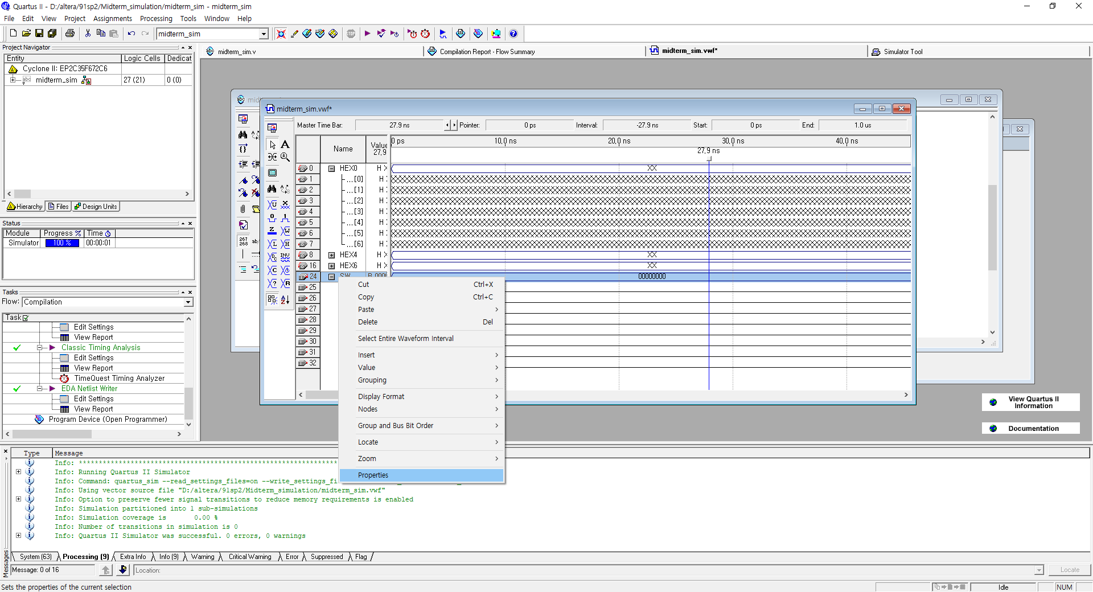
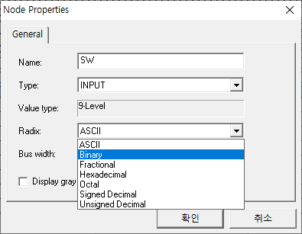
Simulation
If you want to see the binary or hexadecimal, SW -> right mouse -> properties -> change Radix

Slide 21
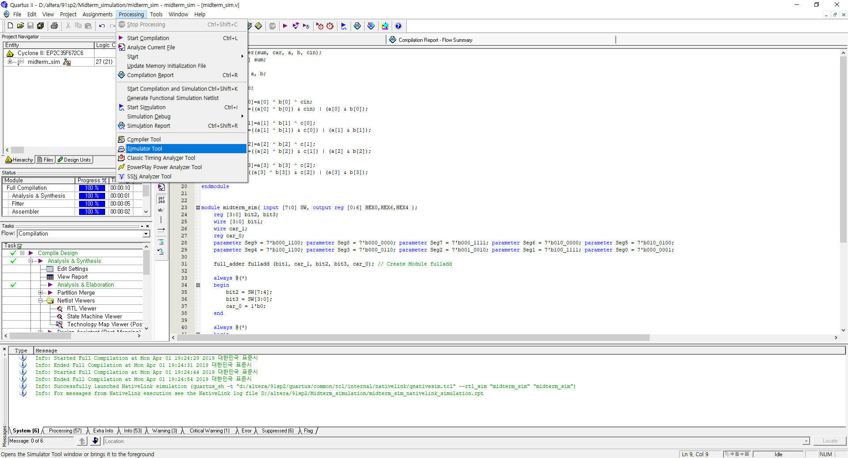
Simulation
Processing -> Simulator Tool -> Find the vwf file -> open

Slide 22
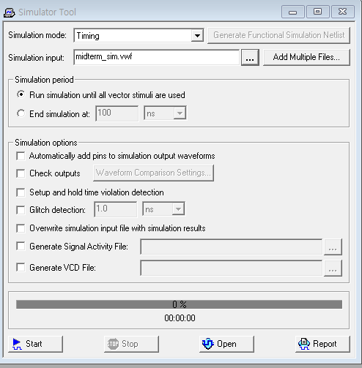
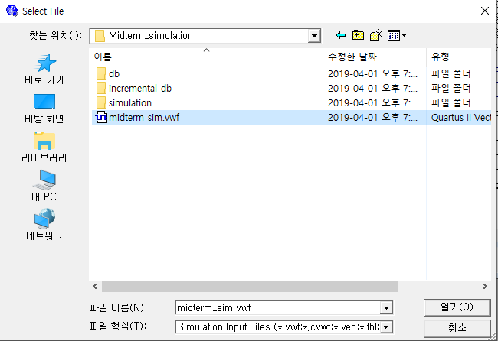
Simulation
Processing -> Simulator Tool -> Find the vwf file -> open

Slide 23
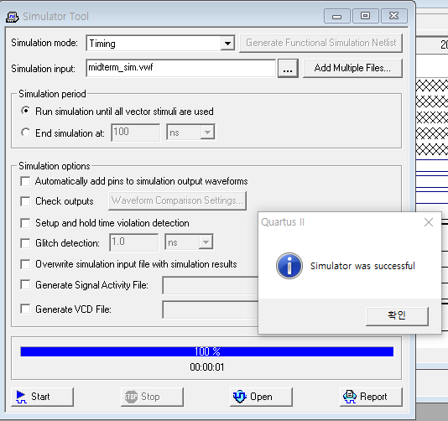
Simulation
Start -> OK -> Report
2
1
3

Slide 24
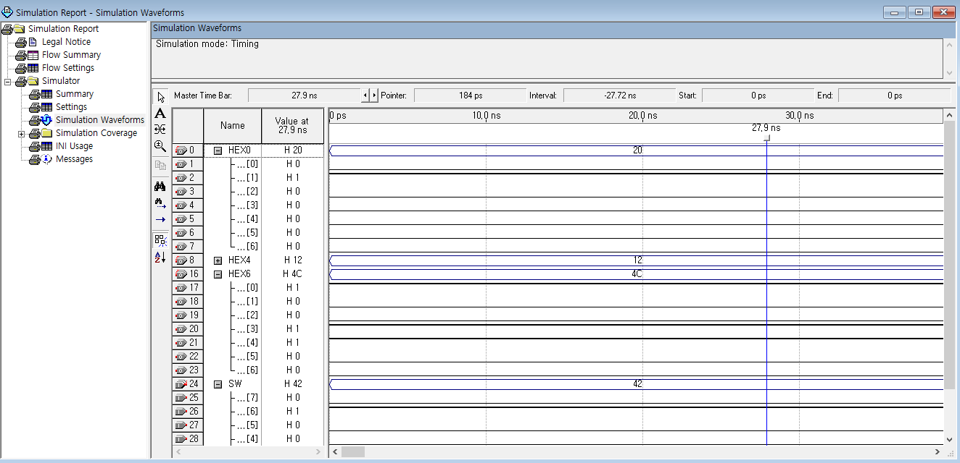
Simulation
Check the Simulation Report
6
4
4+2

Slide 25
Q&A
If you have any question about term project,
please send an e-mail to TA (csh30096@korea.ac.kr)
or use QnA Board in our website
(http://kuld19-1.wixsite.com/kuld)

